Slide 1

Riddle Challenge portal
By
Sejal Singh

Slide 2

Problem Statement
Many students enjoy solving riddles and brain-teasers, but most platforms are either complicated or lack an engaging interface. Users often face difficulty in finding a simple and interactive platform where they can play riddles, track their progress, and compete with others.
The main problem is to design a simple, engaging, and interactive riddle platform where users can:
• Solve riddles in a structured way • Navigate smoothly between pages • View results and leaderboard • Enjoy a clean and attractive interface
This project focuses on building a Riddle Challenge Portal that makes puzzle solving fun while maintaining smooth navigation and user interaction.

Slide 3

Your
Solution
Key features of the solution include
Play Section where users solve riddles
To solve this problem, we developed a web-based Riddle Challenge Portal using HTML, CSS, and JavaScript.
The system provides a clean interface where users can start the game, read riddles, enter answers, and view results.
Result Page that shows user performance
Leaderboard to display top scores
Forum Section for discussion
Smooth navigation between pages
The design focuses on minimal UI, easy navigation, and interactive gameplay to improve the user experience.

Slide 4
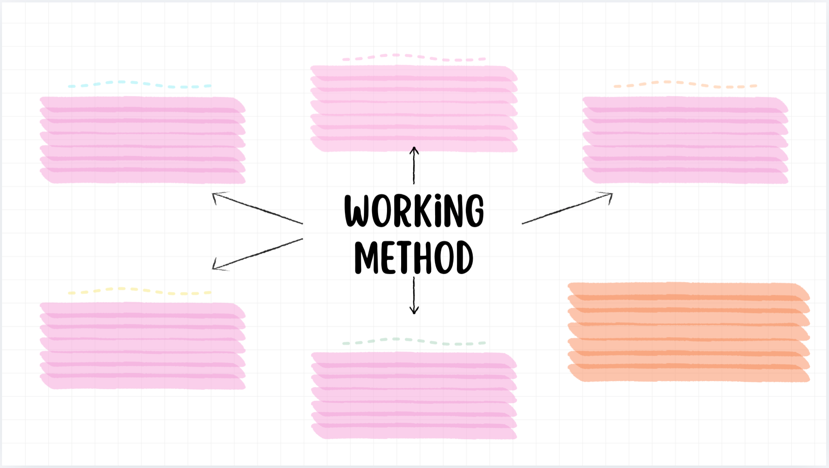
Working (Method / Mind Map)
Step 2 — Riddle Display
Step 3 — Answer Processing
Step 1 — User Interaction
A riddle question appears on the screen and the user can type their answer.
The user opens the portal and clicks the Play button to start solving riddles.
JavaScript checks the entered answer and moves to the next riddle.
Technology used in the project:
Step 4 — Score Calculation
Step 5 — Result and Leaderboard
• HTML – for web page structure
• CSS – for styling and responsive design
• JavaScript – for logic, validation, and interaction
The system keeps track of the correct answers and calculates the final score.
After completing the riddles, the user can view their results and leaderboard ranking.

Slide 5

Conclusion
Future Improvements
The Riddle Challenge Portal successfully demonstrates how a simple web application can create an engaging and interactive puzzle experience.
The system provides an easy-to-use interface, smooth navigation, and dynamic interaction through JavaScript.
This project highlights the practical use of front-end web technologies in building interactive applications.
• User login and authentication
• Database integration for storing scores
• More riddles and difficulty levels
• Multiplayer competition features

Slide 6
Thank You

